Slide 1
Statistics and Reliability: Module 7
Analysis of Variance
(ANOVA)
Notes:
Module Topics
Single-factor analysis of variance (ANOVA)
Two-factor analysis of variance (ANOVA)
Copyright (c) Deere & Company, as an unpublished work. This material is the property of Deere & Company. All use, disclosure, and/or reproduction not specifically authorized by Deere & Company is prohibited.

Slide 2
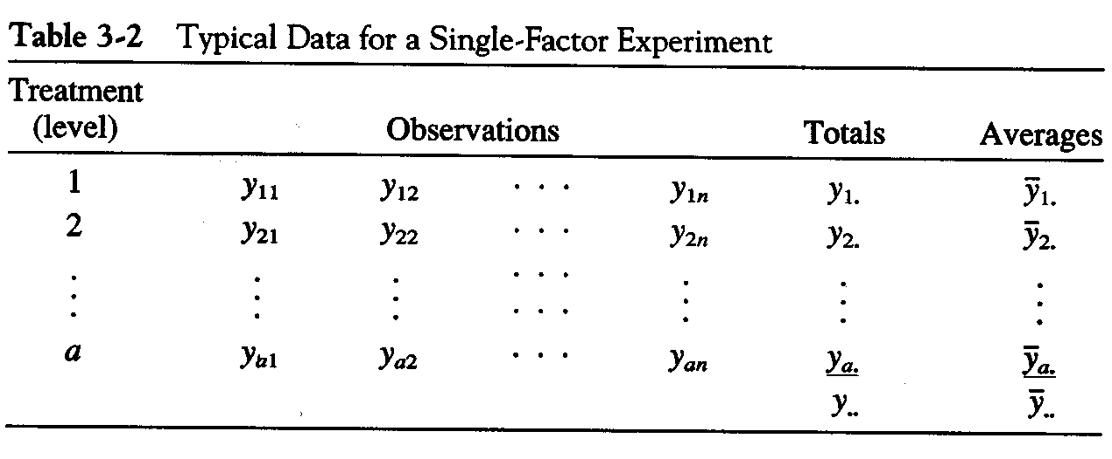
Notes:
ANOVA = ANalysis Of VAriance: To test the Difference in means of two or more samples!
Overview of ANOVA
Test null hypothesis that means are all equal.
Alternative could be true because all of the means are different or just one or more are different.
If we reject the null, then we have to perform further analysis to determine which means are different – post hoc tests.
Use the computer – Statistica.
Single-factor or One-way Analysis of Variance
In general, there will be “a” levels of the factor, or “a” treatments, and “n” replicates of the experiment, run in random order for a completely randomized design.
N = a*n total runs
Objective is to test hypotheses about the equality of the “a” treatment means

Slide 3
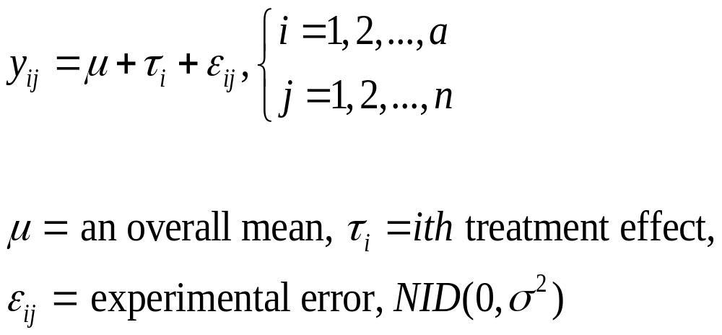
Single-factor Analysis of Variance Model
Notes:
The name “analysis of variance” stems from a partitioning of the total variability in the response variable into components that are consistent with a model for the experiment.
The basic single-factor ANOVA model is shown above.
NIID(0, σ²) = Normally, Independent and Identically Distributed with mean = 0 and constant variance. These are major assumptions we will check later.

Slide 4
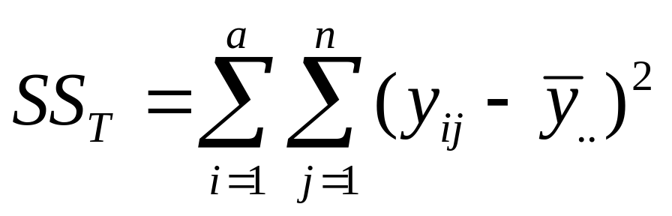
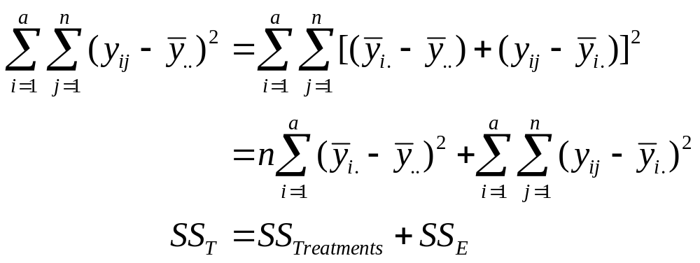
The Analysis of Variance Partitioning
Notes:
Total variability is measured by the total sum of squares.
The basic ANOVA partitioning is shown above.

Slide 5
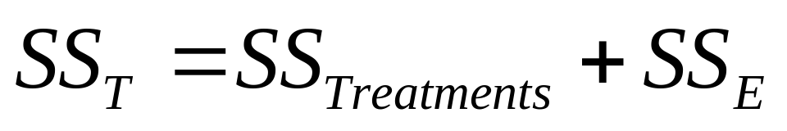
Partitioning of Total Variability
SS_{E}
Group Mean
Overall Mean
SS_{Treatment}
Notes:
The Analysis of Variance
A large value of SS Treatments reflects large differences in treatment means.
A small value of SS Treatments likely indicates no differences in treatment means.
Formal statistical hypotheses are:
H₀: μ₁ = μ₂ = ... μ_{a}
H₁: At least one mean is different

Slide 6
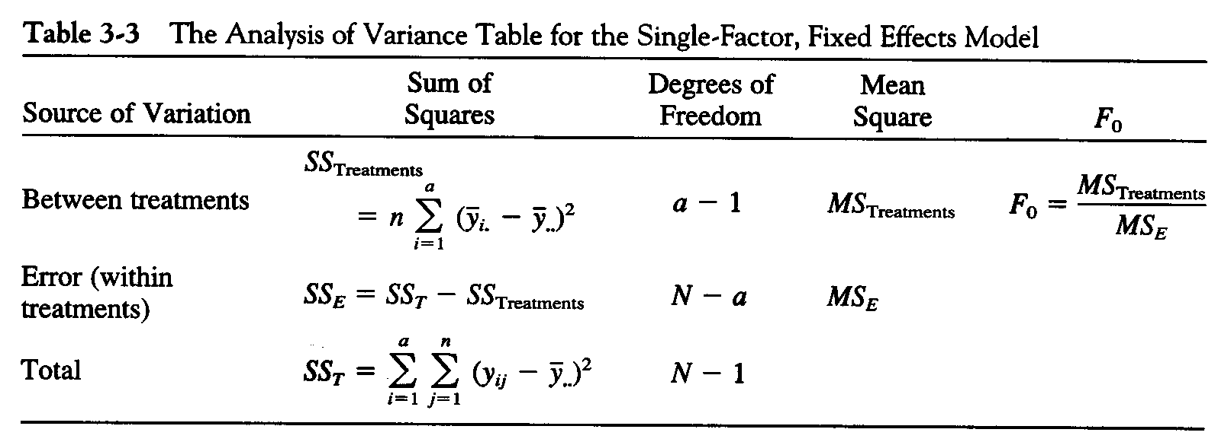
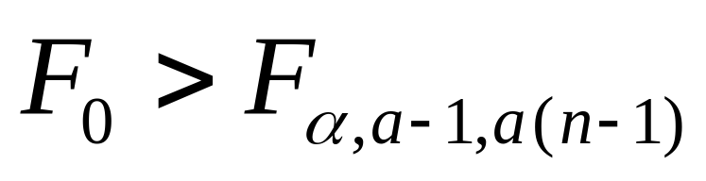
Reject the null hypothesis (equal treatment means) if
Notes:
The Analysis of Variance is Summarized in a Table
We calculate two values of σ² and if there is no difference in treatment means these MS values should be very similar.
The reference distribution for F₀ is the F_{a-1, a(n-1)} distribution.
Note: a(n -1) = N – a, which is used in the table above.

Slide 7
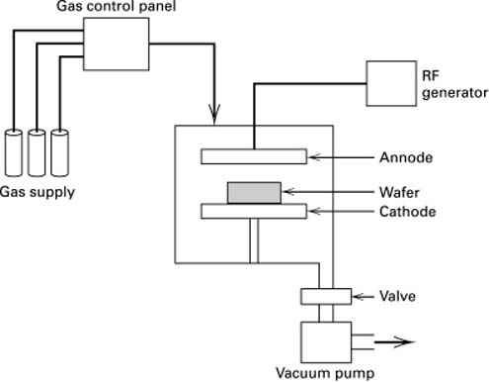
A single-wafer plasma etching tool
Notes:
“An engineer is interested in the relationship between the RF power setting and the etch rate for this tool.” (Montgomery page 61)

Slide 8
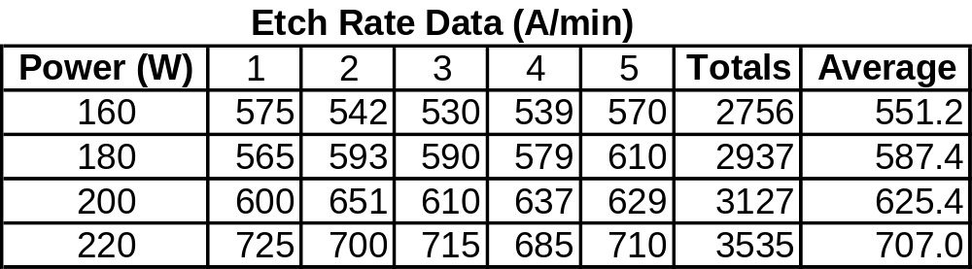
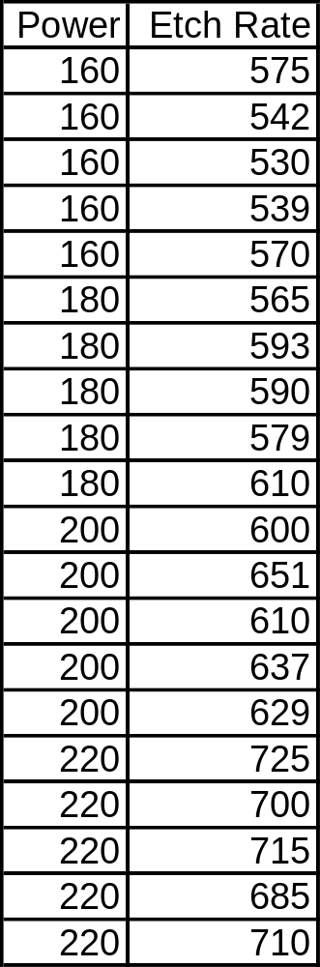
Notes:
Montgomery, Table 3-1 Etch Rate Data (in Å/min) from the Plasma Etching Experiment (page 62)
Enter the data in Statistica, one column for Power and one column for Etch Rate.

Slide 9
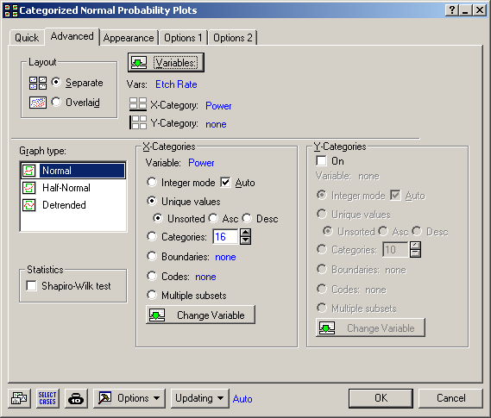
Notes:
Exploratory Data Analysis:
Graphs > Categorized Graphs > Normal Probability Plots
Vars = Etch Rate
X-Catgegory = Power
Separate (shown next – try Overlaid too)
Unique values (otherwise you might get a lot of blank plots for values that do not exist in the dataset)

Slide 10
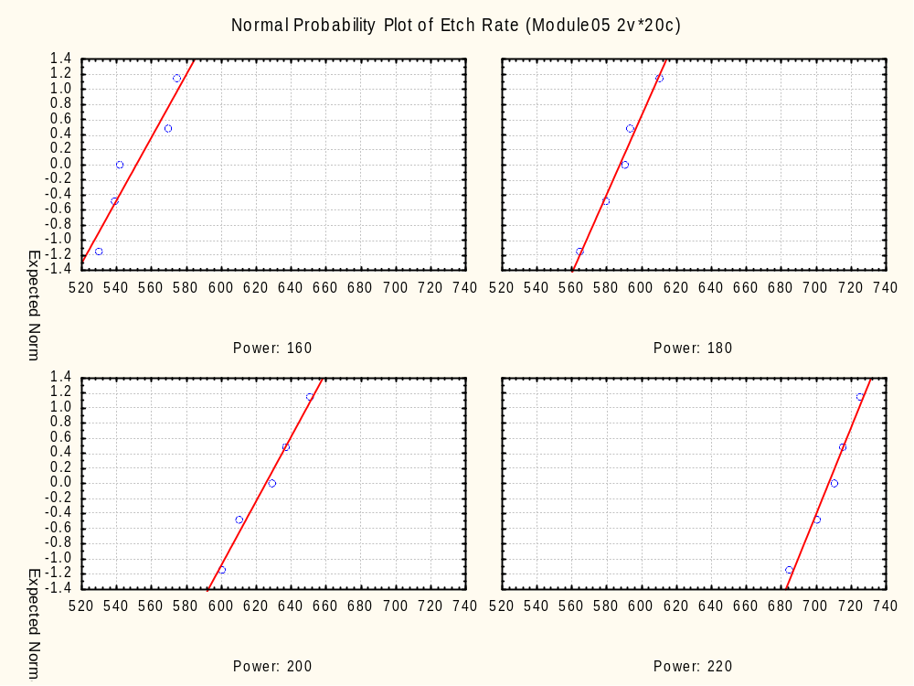
Notes:
Test for Normality of Individual Observations – points seem to fall along a straight line.
Test for Equality of Variances – slopes of the lines look to be similar.

Slide 11
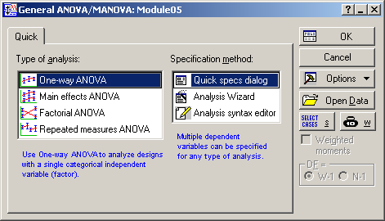
Notes:
Statistics > ANOVA > One-way ANOVA

Slide 12
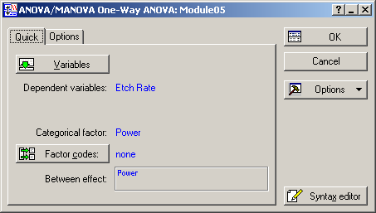
Notes:
Dependent variables = Etch Rate
Categorical factor = Power

Slide 13
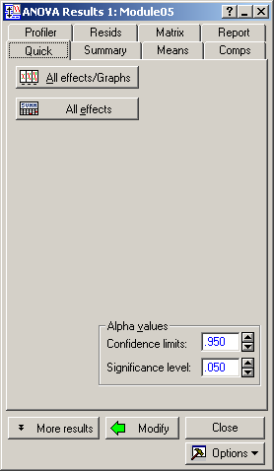
Notes:
Select “All effects/Graphs”

Slide 14
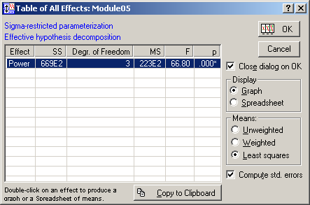
Notes:
Power is statistically significant (p < 0.000).
Click the OK button with the plots on it.

Slide 15
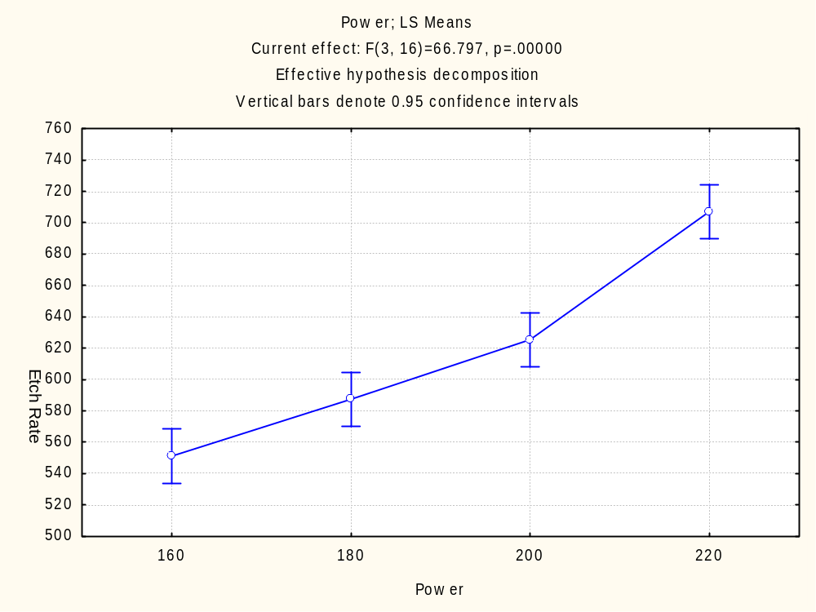
Notes:
Note that we are using a common value of the overall standard error (SE) for the confidence intervals for each group of data.
Can you make any preliminary conclusions about equality of the means from this simple plot?

Slide 16
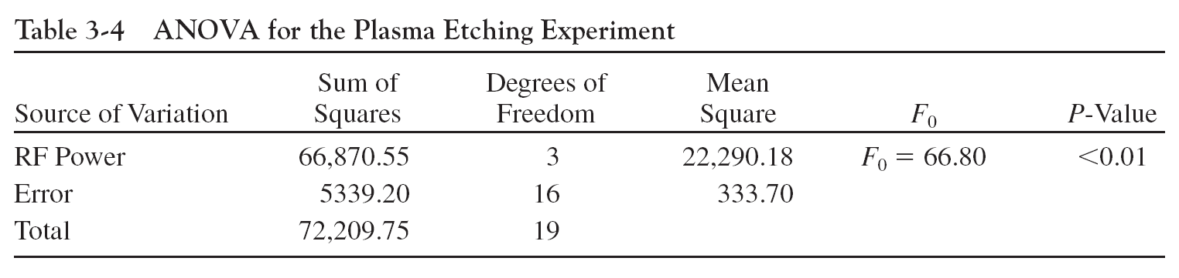
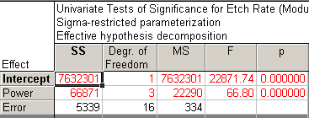
Notes:
Return to “ANOVA Results 1” menu and select “All effects” to get the ANOVA table.
Compare to Table 3-4 ANOVA for the Plasma Etching Experiment (Montgomery page 71).
Remember: when the p is low, the null must go (with credit due to the late Johnny Cochran).

Slide 17
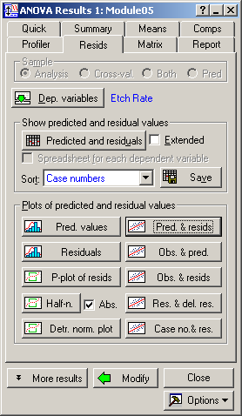
Notes:
Return to “ANOVA Results 1” menu, go to the “Resids” tab and select “Pred. & resids” and then “P-plot of resids” after the first plot is created.

Slide 18
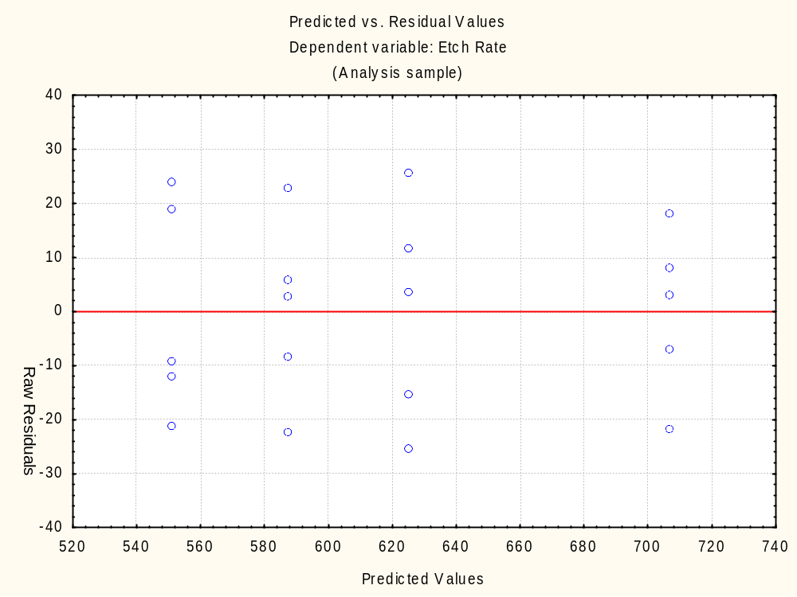
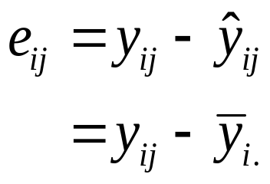
Notes:
Model checking with Residuals (Montgomery p. 75)
Plots of residuals, Residuals e_{ij} = Actual Y_{ij} - Predicted Y_{ij}
Checking assumptions is important
Fit versus Residuals – random?
Normality – normal probability plot
Constant variance – Levine’s Test
Independence
Have we fit the right model?
Later we might talk about what to do if some of these assumptions are violated.
Figure 3-6 Plot of residuals versus fitted values (Montgomery page 79)
“If the model is correct and if the assumptions are satisfied, the residuals should be structureless: in particular, they should be unrelated to any other variable including the predicted response.”

Slide 19
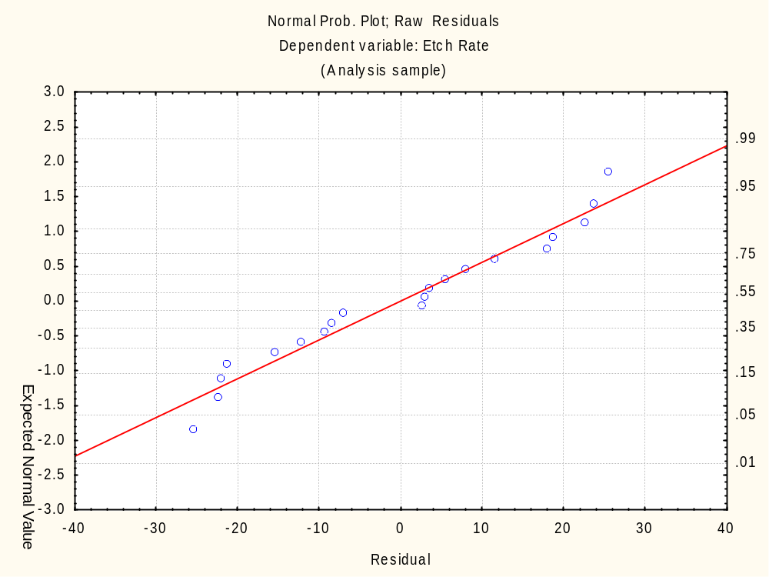
Notes:
Model Adequacy Checking in the ANOVA (Montgomery page 77)
Normal probability plot of residuals – residuals appear to have a normal distribution

Slide 20
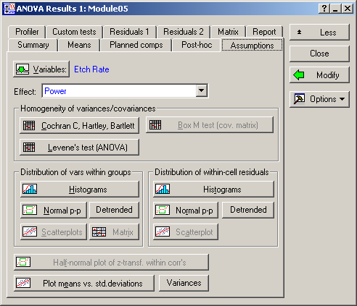
Notes:
Return to “ANOVA Results 1” menu, select the “More Results” button on the bottom left-hand side, go to the “Assumptions” tab and select “Levene’s test (ANOVA)”.

Slide 21
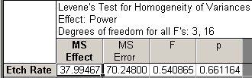
Notes:
Test for Equality of Variances – insufficient evidence that the variances are not equal (p-value = 0.66). This confirms the visual test we did earlier.

Slide 22
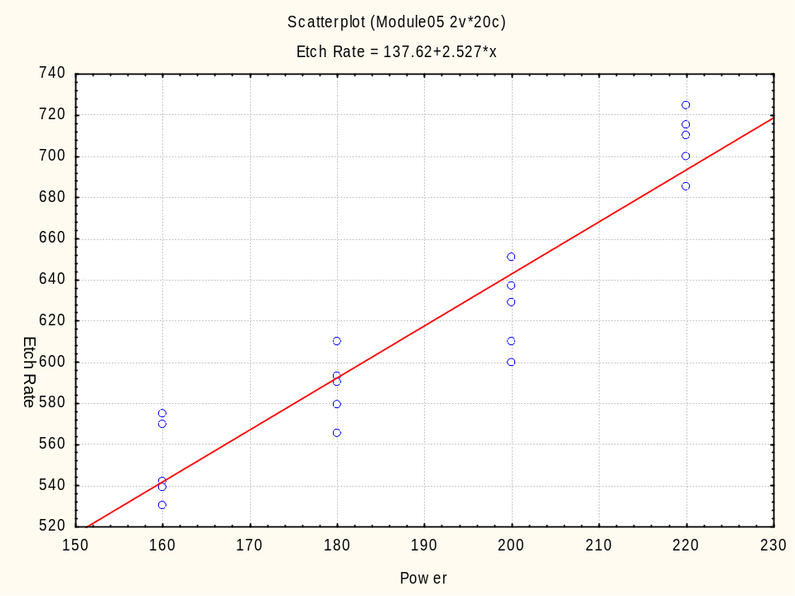
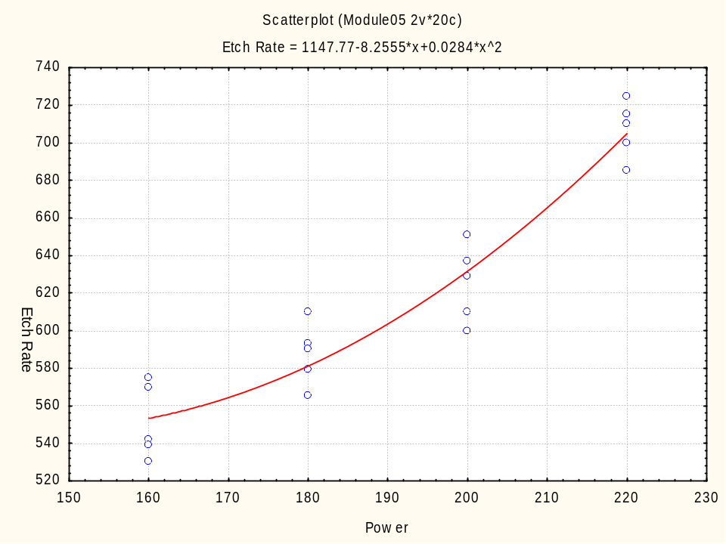
Notes:
Graphs > Scatterplots
X = Power
Y = Etch Rate
1st Fit = Linear
2nd Fit = Polynomial
Figure 3.10 Scatter diagrams and regression models for the etch rate data of Example 3-1 (Montgomery p. 86)
3-5.1 Compare equations to middle of Montgomery page 86 plots done in “2D Scatterplots”.
Do you think a linear model is appropriate? Probably not, but that’s a more advanced topic for the Regression module.

Slide 23
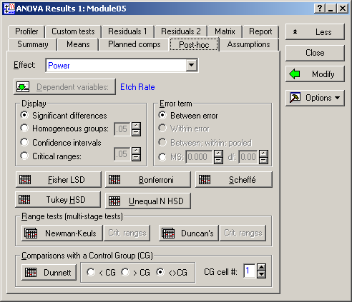
Notes:
Post-ANOVA Comparison of Means (Montgomery page 93)
The analysis of variance tests the hypothesis of equal treatment means.
Assume that residual analysis is satisfactory.
If that hypothesis is rejected, we don’t know which specific means are different .
Determining which specific means differ following an ANOVA is called the multiple comparisons problem.
There are several ways to do this. We will use pairwise t-tests on means, Tukey HSD in this case.
Return to “ANOVA Results 1” menu, go to the “Post-hoc” tab and select “Tukey HSD”.

Slide 24
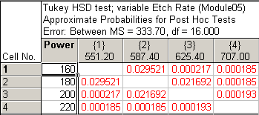
Notes:
Statistica Output
The column gives the cell number and the correspond Power level; the row gives the same cell number and the mean of the cell.
The intersection of column and row gives the p-value for the null hypothesis that the means column and the row are equal. In this case all p-values are below 0.05 and they are highlighted in red. This statistically confirms the visual test we did earlier.
Compare to Tukey’s test results on Example 3-7 on Montgomery page 95.
“The Tukey procedure indicates that all pairs of means differ.”

Slide 25
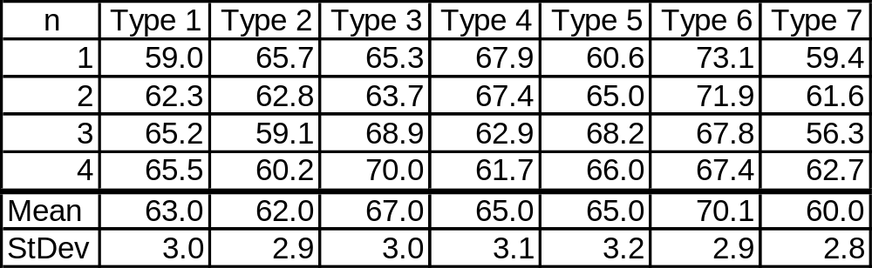
24.10 Example 24.1: Single-factor Analysis of Variance
Notes:
Page 507: “The bursting strengths of diaphragms were determined in an experiment. Use analysis of variance techniques to determine if there is a statistically significant difference at a level of 0.05.”
First we need to reformat this data in 2 columns:
Type = 1, 2, 3... 7
Strength

Slide 26
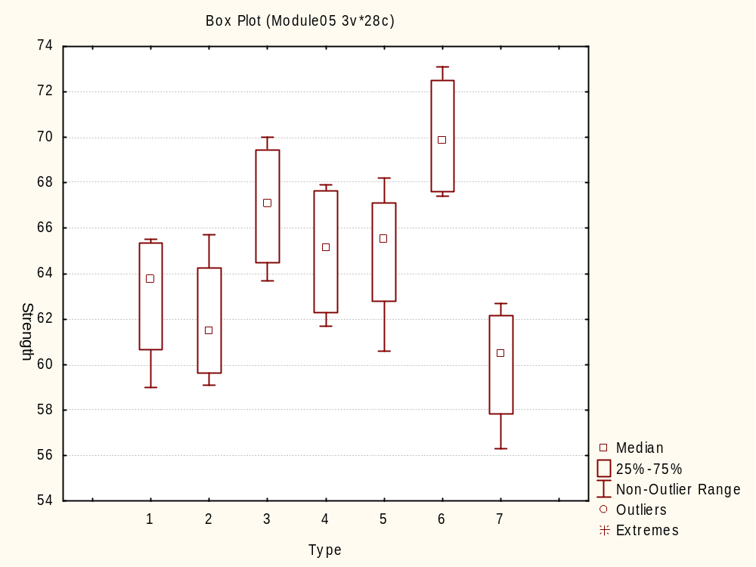
Notes:
First let’s do some exploratory data analysis:
Graphs > 2D Graphs > Box Plots
Compare to FIGURE 24.1 Box plots by response type. Means are indicated by solid circles.
The median is shown as a square above and the mean is not shown.

Slide 27
Notes:
Statistics > ANOVA > One-way ANOVA

Slide 28

Notes:
Dependent variable = Strength
Categorical factor = Type
Click OK.

Slide 29
Notes:
Click the “All effects/Graphs” button.

Slide 30
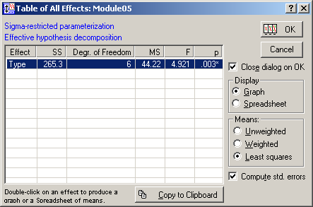
Notes:
Type is statistically significant (p = 0.003).
Click the OK button with the graph on it.

Slide 31
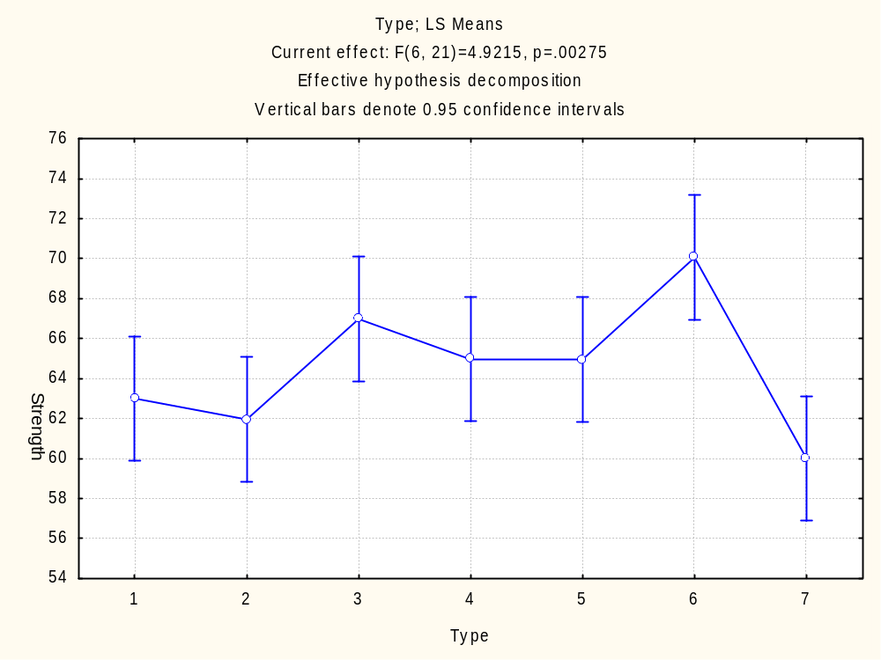
Notes:
Compare to FIGURE 24.2 Dot plot by type. Group means are indicated by line.
The group means are shown as circles above, and the 95% confidence intervals are shown as the ends of the bars. This the analogous plot to the dot-matrix plot shown horizontally on the bottom half of page 509. You can see the values reported on the bottom of page 509 by using the “Least Squares Means” button on the “Means” tab of the “ANOVA: Results 1” menu.

Slide 32
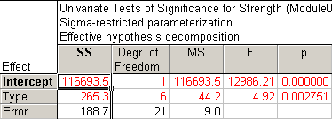
Notes:
Click the “All effects” button on the “ANOVA: Results 1” menu.
Compare to the table on page 509: One-Way Analysis of Variance.

Slide 33

Notes:
Click the “More results” button on the “ANOVA: Results 1” menu and go to the “Assumptions” tab.
Click “Cochran C, Hartely, Bartlett” and then “Levene’s test (ANOVA)” to check the homogeneity of variances assumption.

Slide 34

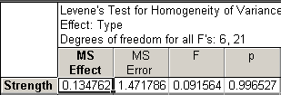
Notes:
Compare to the Homogeneity of Variance Test for Response section of FIGURE 24.3 Single-factor analysis of variance: tests of the model. on page 510.
There is no reason to question that assumption – both tests have extremely high p-values.

Slide 35
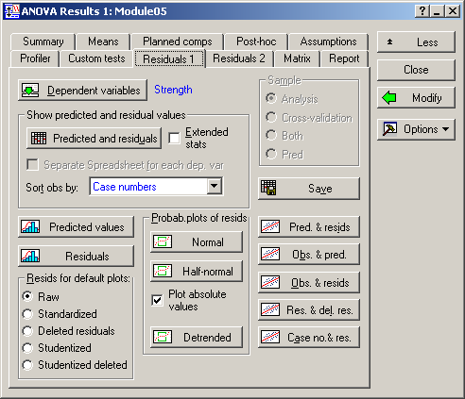
Notes:
Go to the “Residuals 1” tab on the “ANOVA: Results 1” menu.
Then click on “Normal” with the probability plot symbol, “Case no. & res.” with the scatter plot symbol, “Residuals” with the histogram symbol, and “Pred. & resids” with the scatter plot symbol.

Slide 36
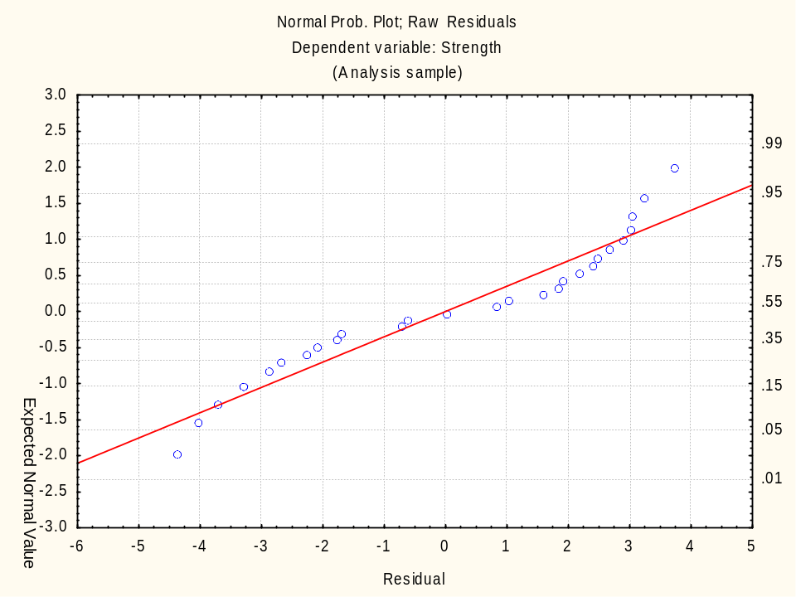
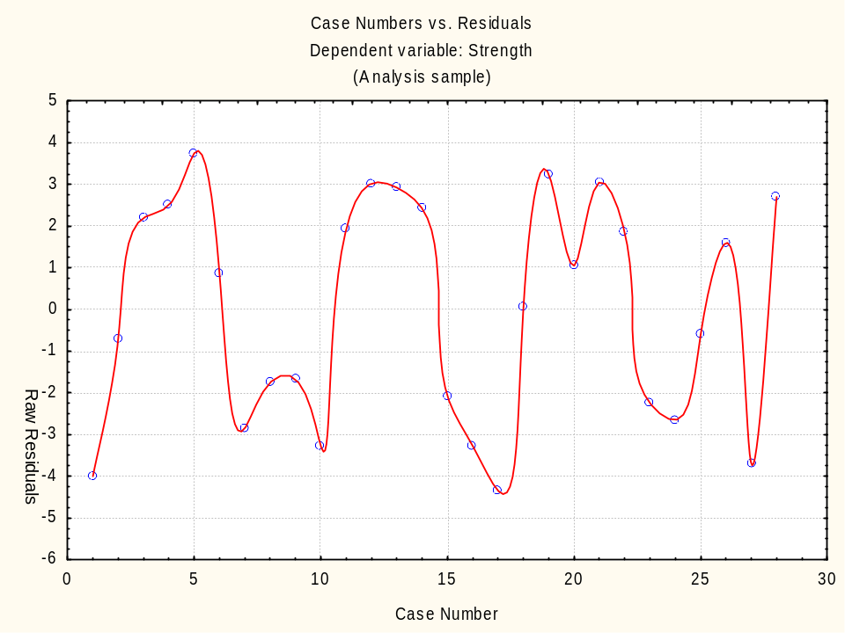
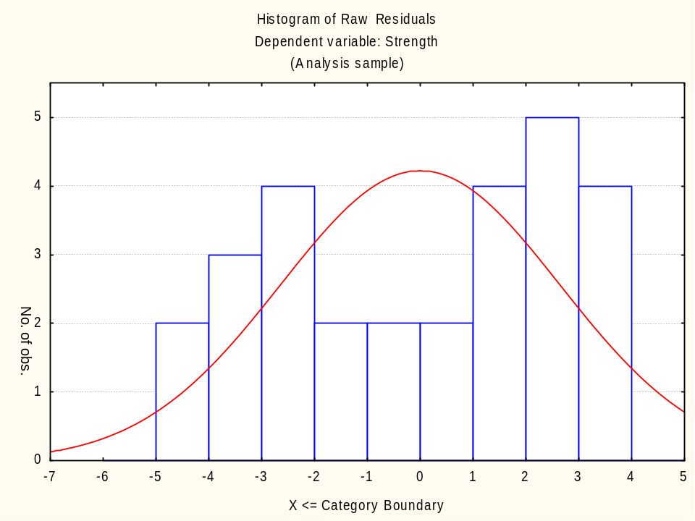
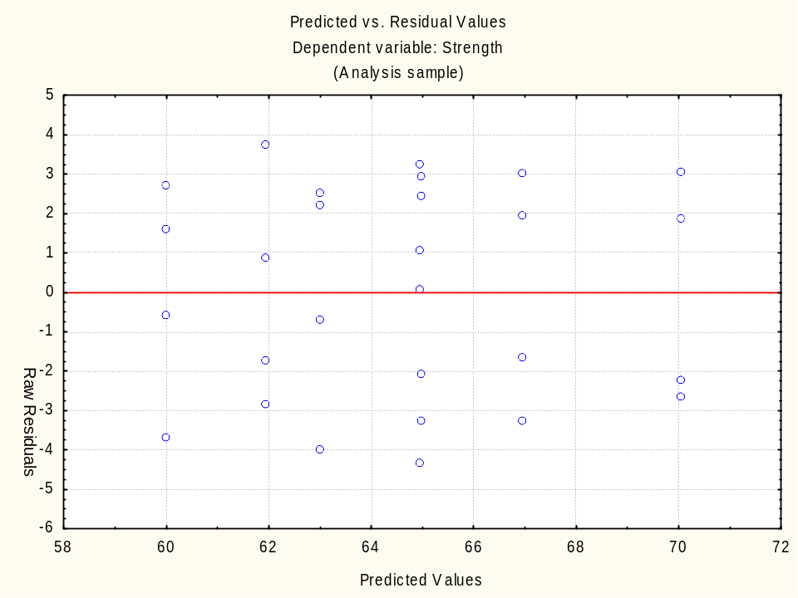
Notes:
Compare to the Residual Model Diagnostics section of FIGURE 24.3 Single-factor analysis of variance: tests of the model. on page 510.
Note that for the “Case no. & res.” plot in the upper right-hand corner, the X-axis scale was changed from -5:35 to 0:30 and a spline fit was added to connect the dots, but the lines are not straight. We could have saved the residuals and used a Individuals/Moving Range chart, but that comes later in the SPC module. Regardless, there seems to be some cyclicality, so I’d investigate how the data was sampled – there might be clues about additional sources of variation or the data was not randomly collected, which can hide other sources of variation.
And while the author states that there is no pattern apparent, the Normal Probability Plot (with the dots snaking around the line) and the Histogram (with peaks on each side) seem to show bimodality in the data. There should be more values in the middle. The cyclical nature of the residuals probably explains why there are more values at the extremes than expected.
Overall, I’d seriously question how the experiment was conducted. Either there is a variable missing that was not controlled or there is something else going on that we don’t understand, so any conclusion we draw is not likely to be the “whole truth and nothing but the truth.” Normally we would look at pairwise comparisons of the mean using the Post-hoc tab, but that’s meaningless if the model is bad.

Slide 37
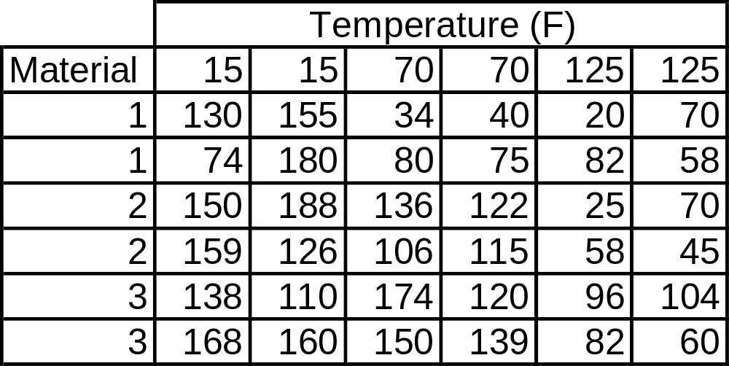
Table 25.3 Life Data (in hours) for Battery Two-Factorial Design
Notes:
Page 526: “A battery is to be used in a device subjected to extreme temperature variations... The engineer would like to determine if one of the material types is robust to temperature variations.”
First we need to reformat this data in 3 columns:
Temp = 15, 70, 125
Material = 1, 2, 3
Life

Slide 38
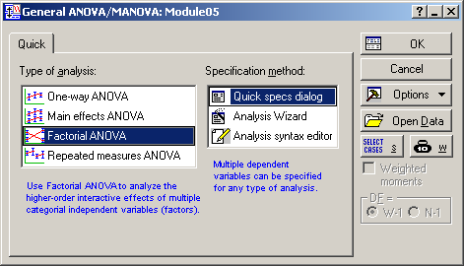
Notes:
Statistics > ANOVA > Factorial ANOVA

Slide 39
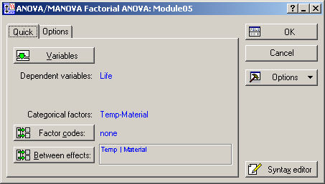
Notes:
Dependent variables = Life
Categorical factors = Temp and Material

Slide 40
Notes:
Click the “All effects/Graphs” button.

Slide 41
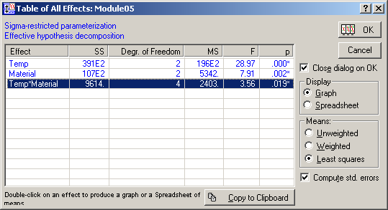
Notes:
All three terms are statistically significant: Temp (p < 0.000), Material (p = 0.002) and the Temp*Material interaction (p = 0.019)
Highlight the row “Temp*Material” and click the OK button with the graph on it.

Slide 42
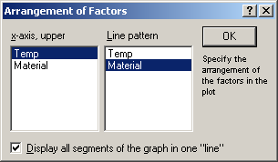
Notes:
X-axis, upper = Temp
Line pattern = Material

Slide 43
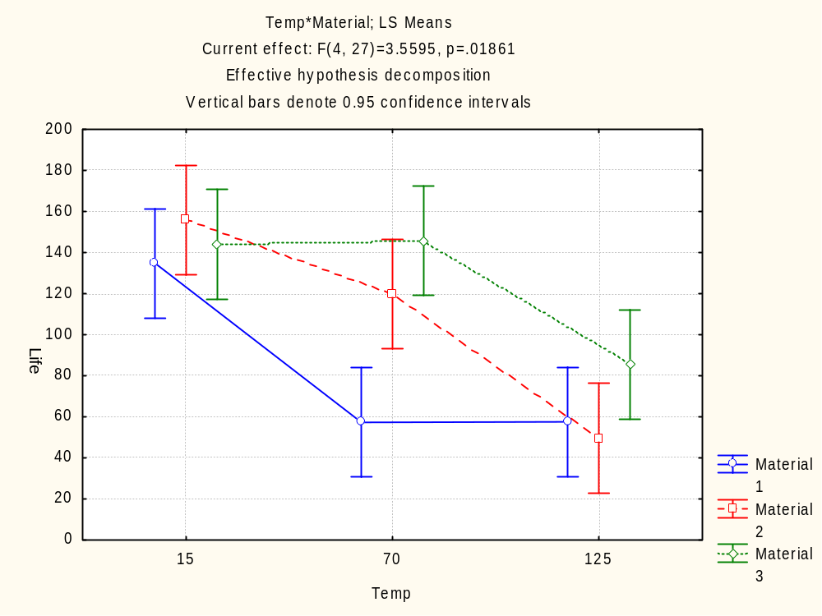
Notes:
Compare to FIGURE 25.1 Mean battery life as a function of material and temperature.
The x-axis of the 3 lines are slightly offset so they don’t interfere with each other and I find that slightly annoying. We can create a better chart ourselves with a categorized scatter plot using the overlaid feature with lowess smoothing.
Based on this plot, which material would you select? Which material would you not select?

Slide 44
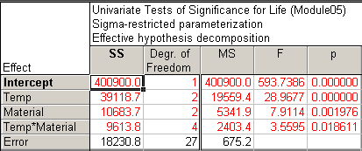
Notes:
Return to the “ANOVA Results 1” menu and select the “All effects” button.
Compare the result to the table on page 527 labeled “Two-Way Analysis of Variance”.

Slide 45
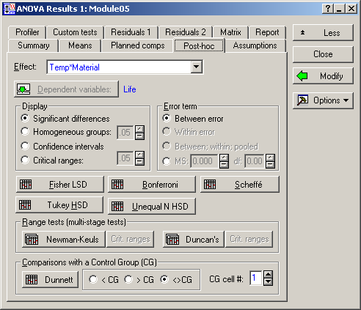
Notes:
Return to the “ANOVA Results 1” menu, select the “More results” button and the go to the “Post-hoc” tab.
Then select the “Tukey HSD” button.

Slide 46
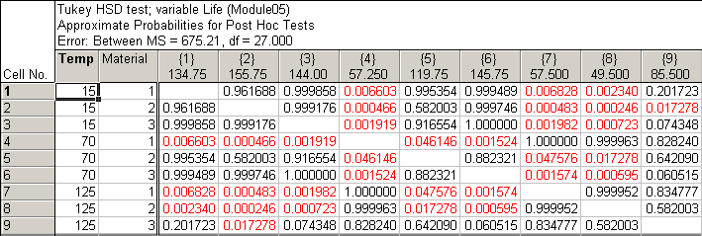
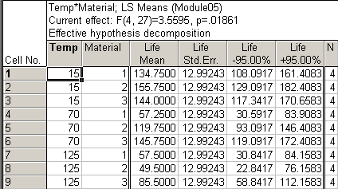
Notes:
The table of means from the “Means” tab and “Least squares means” button are also shown for better understanding the table above it. The row and column numbers are the same combination, with the Cell No. description listed in the row and the Cell Mean listed in the column header. So to compare cells, pick a row and the go across the table and select a column. The p-value for differences in means are listed.
Compare the results to the table on page 529 labeled “Tukey Simultaneous Tests”. The p-value in row 4 and column 5 match (0.046146), but the p-value in row 4 and column 5 (0.001524) do not match, but the conclusion is the same. Also the p-value in row 5 and column 6 (0.882321) do not match, but again the conclusion is the same.
The Tukey HSD is based on a “studentized range distribution”, and we don’t have a Probability Distribution Calculator to check the p-values in Statistica or to the analogous calculation Minitab, but something is not the same between the two packages.

Slide 47

Notes:
Return to the “ANOVA Results 1” menu and go to the “Residuals 1” tab.
Select “Normal” in the “Probab.plots of resids” section and “Pred. & resids” with the scatter plot icon.

Slide 48

Notes:
Then go to the “Residuals 2” tab.
Select Temp as the X and Resids as the Y and click the “Scatterplot of selected X vs. Y” button.
Then Material the X and Resids and click the “Scatterplot of selected X vs. Y” button.

Slide 49




Notes:
Compare to FIGURE 25.3 Residual plots for analysis of variance of battery life.
The top 2 plots look OK – Normal distribution and random errors across the predicted values.
The bottom 2 plots are a concern – maybe decreasing variance – but the author suggests it’s nothing to get too worried about.
Given this is a lifetime problem, which tend to be skewed, using a natural log transformation of the Life values would probably be better, but that’s an advanced topic.

